Slide 1


Slide 2


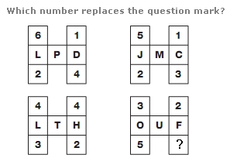


Slide 3


Orientation

Slide 4


GROUND RULES
During Session
Audio and web cam should be disabled
Any query post in chat session
Chat session is only for relevant doubts/query to solve
Emojis in chat session is not allowed

Slide 5
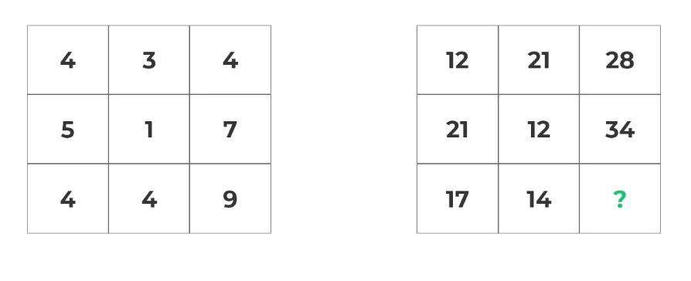

Slide 6


ATTENDANCE
Attendee sheet will be downloaded in regular intervals of time during the session.
Make sure you are present on time for the session
First 5 mins of the session is buffer time.
Notes:
First 5 mins of the session is buffer time after that if students are attending the session we can mark them absent.

Slide 7
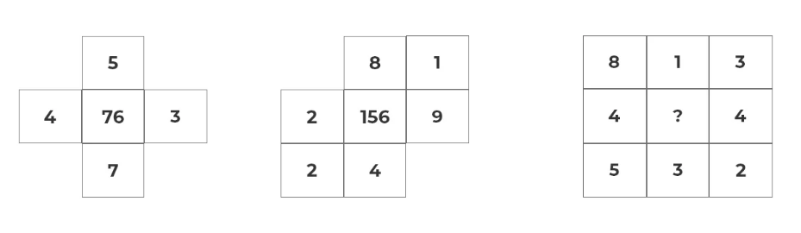

Slide 8

ASSESSMENTS
Internal Assessment I – 15 Marks
Internal Assessment II – 15 Marks
CAT -1 – 15 Marks
CAT -2 – 15 Marks
FAT – 40 Marks
NOTE: The mode and form of conducting tests will be shared through respective authorities.

Slide 9
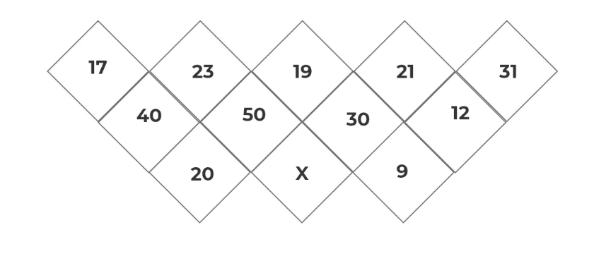

Slide 10
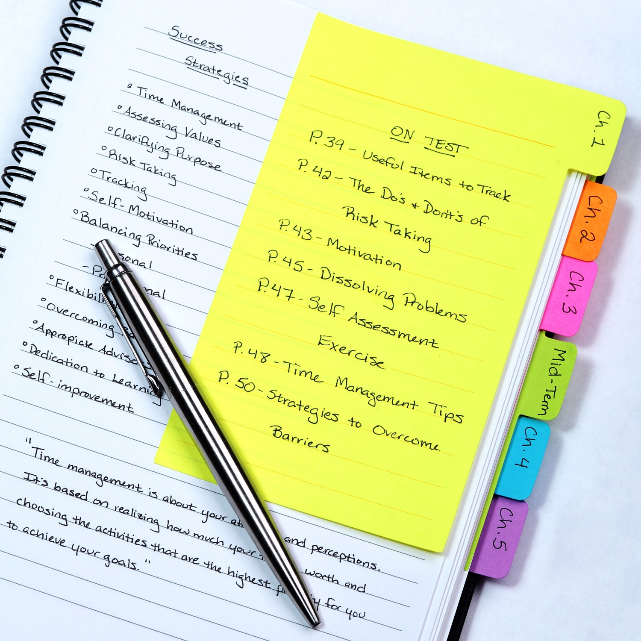
MATERIALS
Materials will be provided on course page(VTOP Portal) as well as Microsoft Teams.
Each session will be recorded and will be saved in Microsoft Teams
Any doubts in attendance or marks mail to
notifications@ethnus.com

Slide 11
Thank You
Our Official Facebook page: Ethnus
Instagram Name : code_mithra
Telegram channel link: https://t.me/ethnuscodemithra/130
Youtube Channel: Ethnus Codemithra

